Slide 1
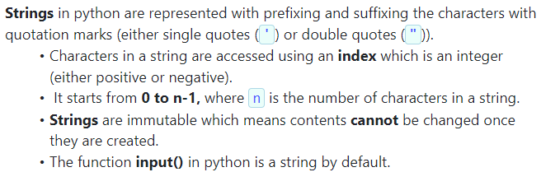
Strings in Python

Slide 2

Example(4.1)
Write a program that prompt user to input a string using the input() function and print the entered string
.

Slide 3
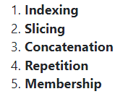
Fundamentals operations which can be performed on strings

Slide 4
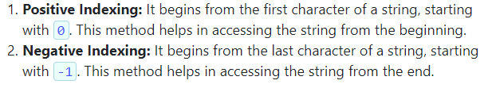
Types of Indexing

Slide 5
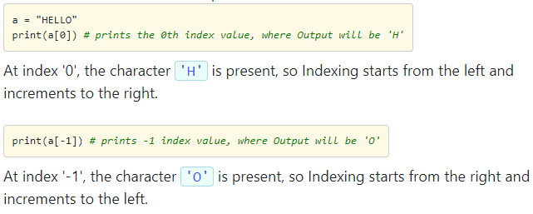
Example

Slide 6
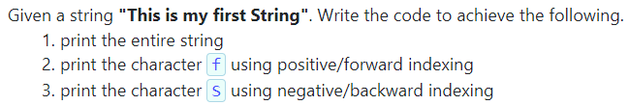
Problem statement(:4.1)

Slide 7
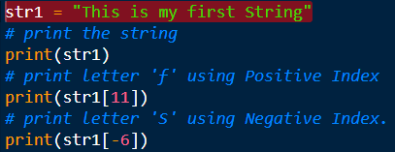
Example

Slide 8
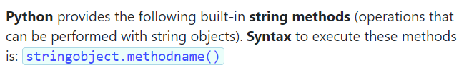
Built-in String Methods

Slide 9
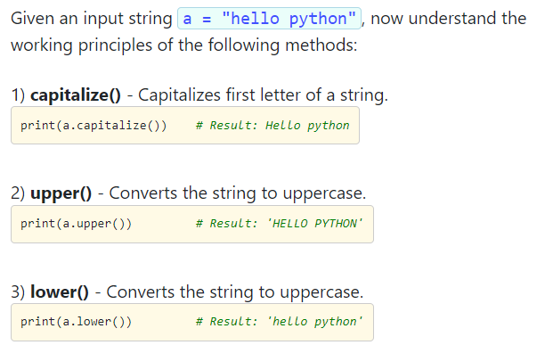
Example

Slide 10
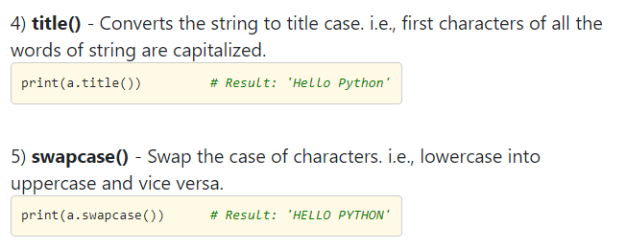
Contd…

Slide 11
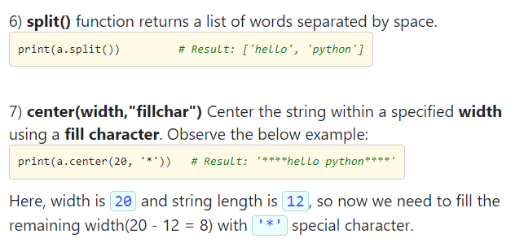
Contd…

Slide 12
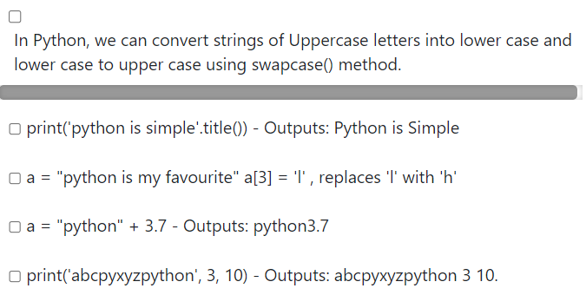
Select the correct option

Slide 13
Option 1,5 is correct

Slide 14
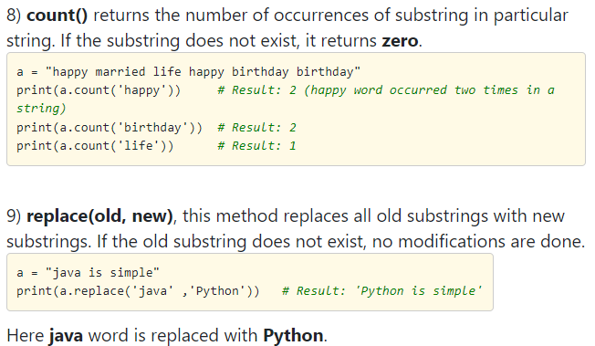
Contd…

Slide 15
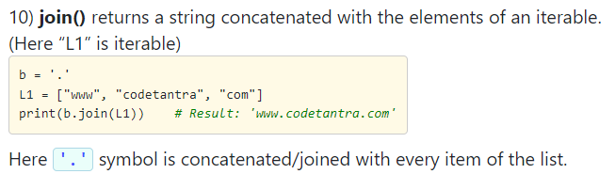
Contd…

Slide 16
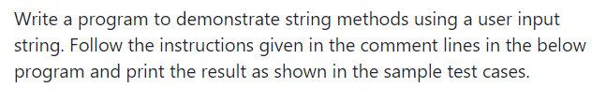
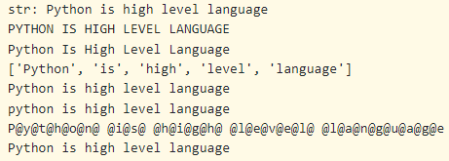
Problem statement(2.2)

Slide 17
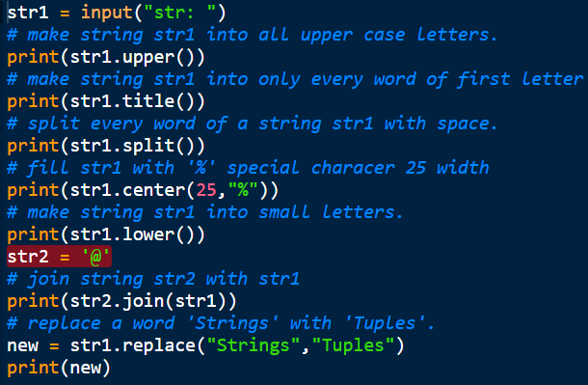
Contd…

Slide 18
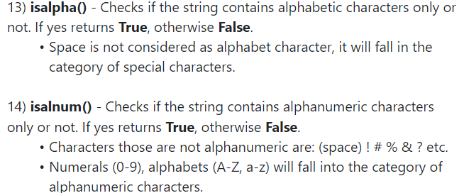
Contd…

Slide 19
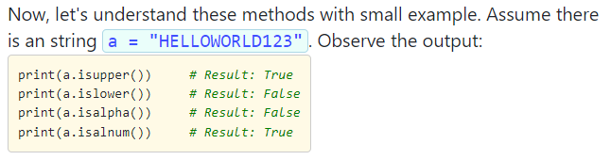
Example

Slide 20
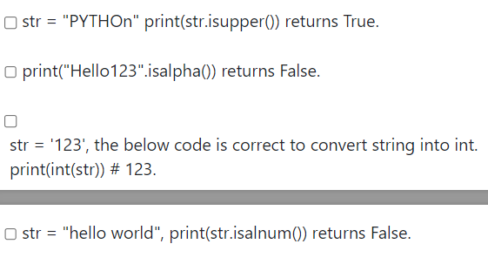
Select the correct option

Slide 21
Options 2,3,4 are correct

Slide 22
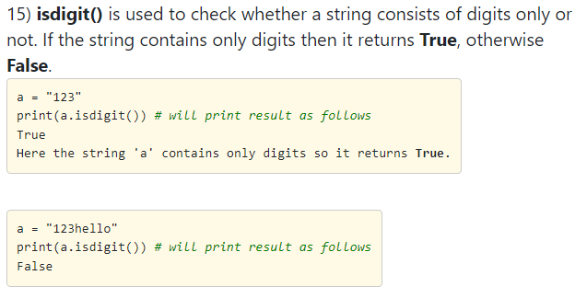
Contd…

Slide 23
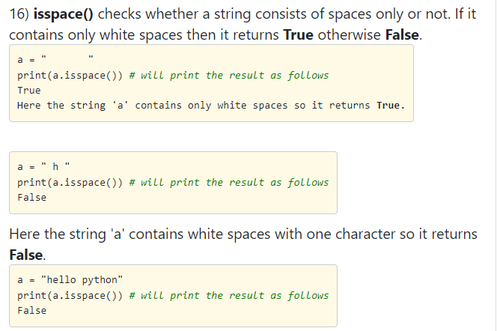
Contd…

Slide 24
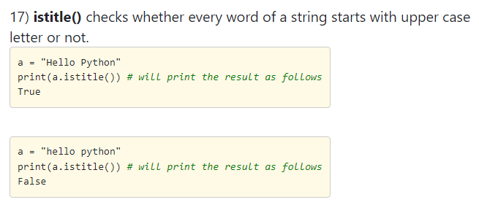
Contd…

Slide 25
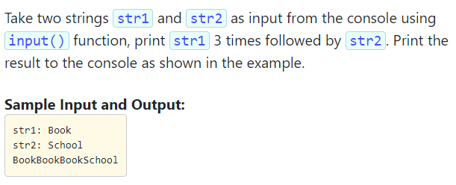
Problem statement(2.4)

Slide 26
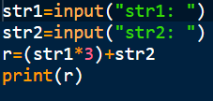

Slide 27
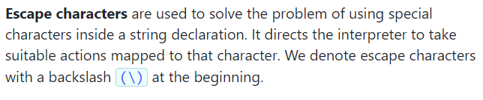
Escape sequence is Strings

Slide 28
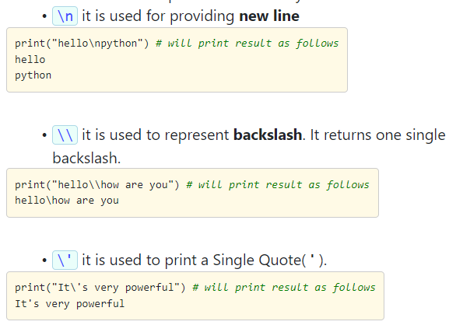
Contd…

Slide 29
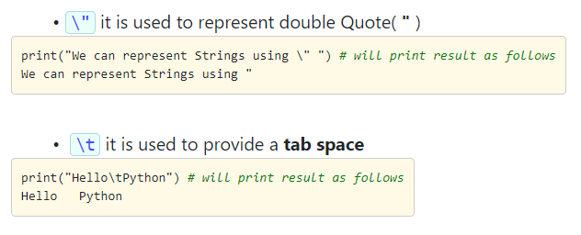
Contd…

Slide 30

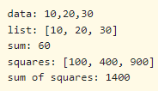
Problem statement(5.4)

Slide 31
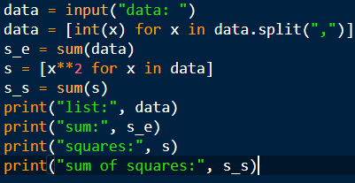

Slide 32
Note:
data.split(",") splits the string data into a list of substrings based on commas. The list comprehension [int(x) for x in data.split(",")] iterates over each substring (denoted as x) in the list created. For each x, it converts x to an integer using int(x) and collects these integers in a new list.
s = [x**2 for x in data] is creating a new list s using a list comprehension. It takes each element x from the data list and calculates its square (x**2), then stores these squared values in the new list s.

